Slide 1
PROJECT MANAGEMENT TOOL
Presented By:
Mr. Divyanshu Arora (240310120006)
Miss Mitali Shrivastava (240310120007)
Mr. Suraj Gupta (240310120013)
Guide:
Mr. Pankaj Kumar Mahto
Senior Project Engineer, CDAC Delhi

Slide 2
INTRODUCTION
The goal of this project is to develop a comprehensive project management platform tailored to small-scale businesses.
The software will facilitate seamless project execution, team collaboration, and task management, thereby enhancing productivity and profitability.
Users can manage all project phases, from planning and execution to monitoring and closure, through a single, integrated platform.

Slide 3
Software Requirements
Designing End: React JS , HTTP Client using axios Library
Development End: Spring Boot Rest Controller, Autowiring is used as well to inject the Dependencies
Data Base : MySQL.
Web Server: TOMCAT Web Server.
Tools : VS Code, Spring ToolSuit4, MySQL Workbench 8.0 CE, Browser

Slide 4
Proposed Solution
A comprehensive project management tool specifically designed to address the challenges faced by small to medium-sized businesses.
This tool integrates modern technologies and best practices to provide an efficient, scalable, and user-friendly platform for managing projects, resources, and team collaboration.
The solution is built with a focus on simplicity, flexibility, and security, ensuring that it meets the unique needs of small businesses while remaining cost-effective.

Slide 5
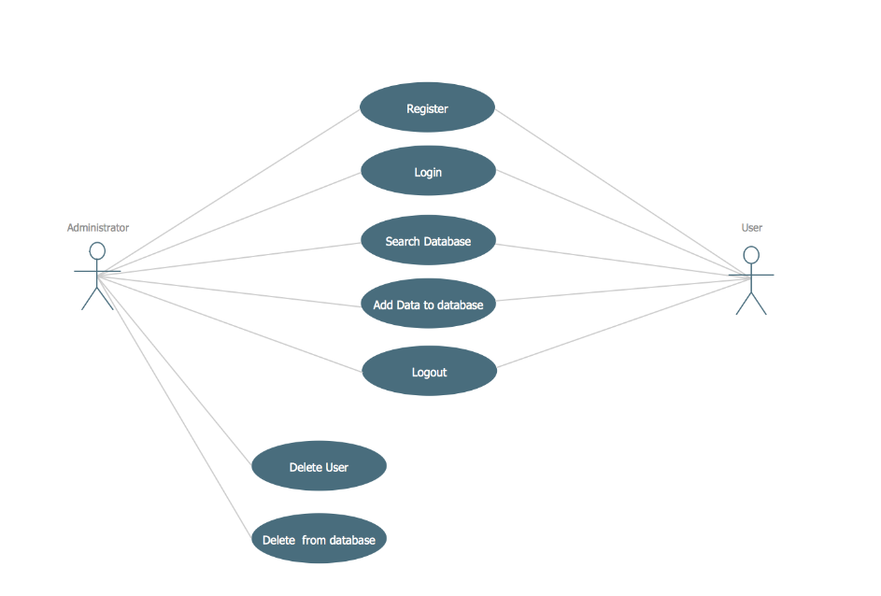
Application Structure:

Slide 6
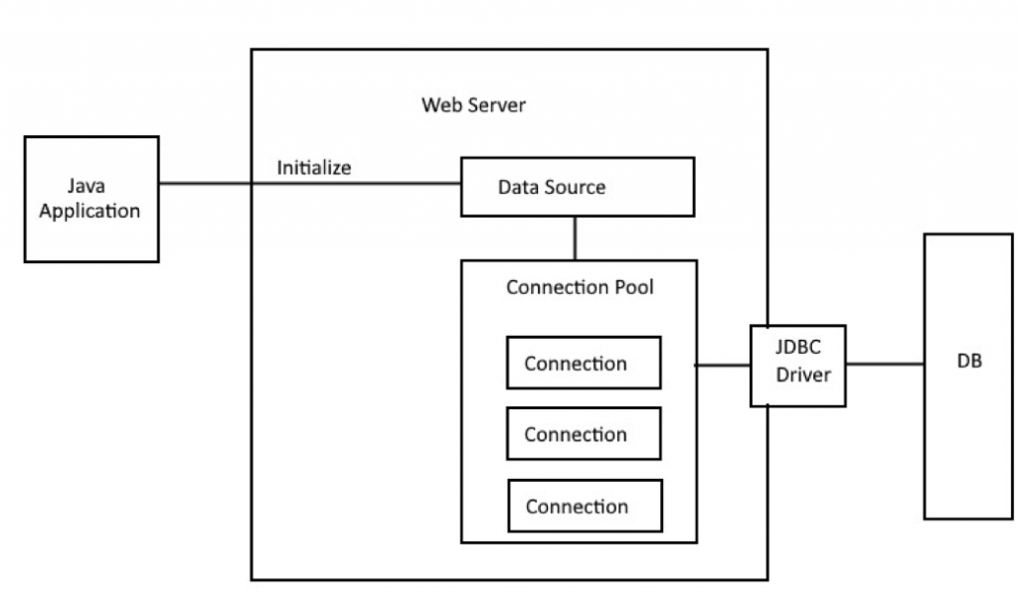
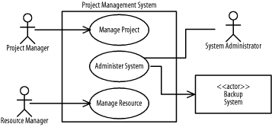
System Architecture:

Slide 7
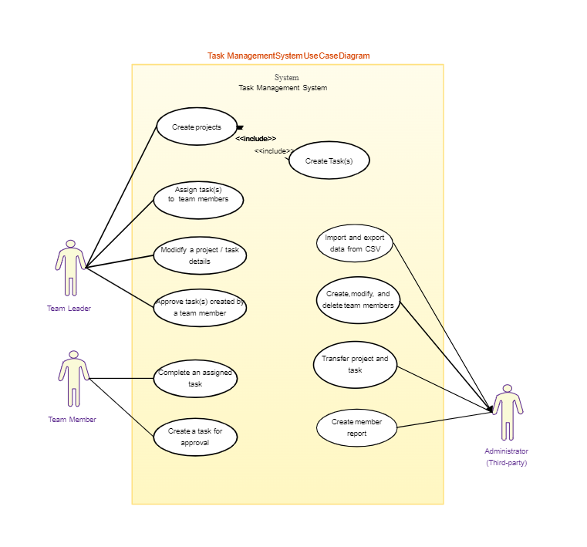
Use-case Model

Slide 8
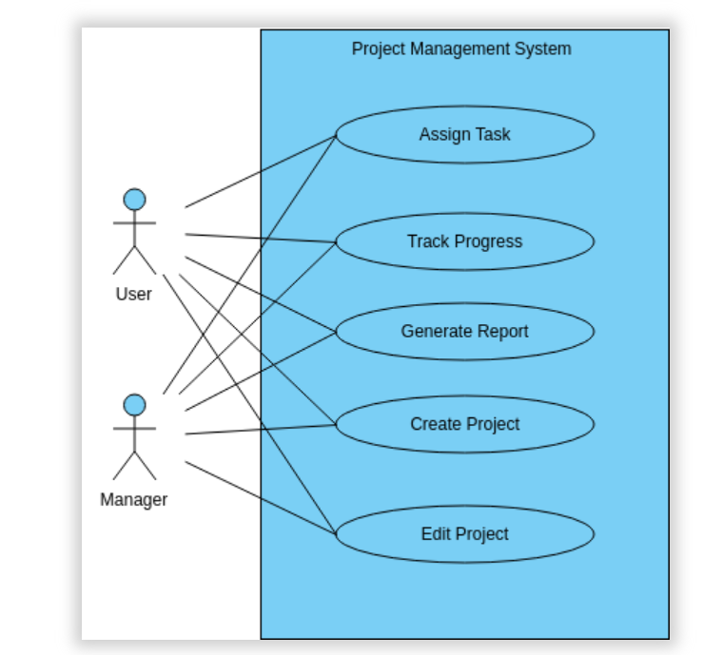
Admin Case

Slide 9
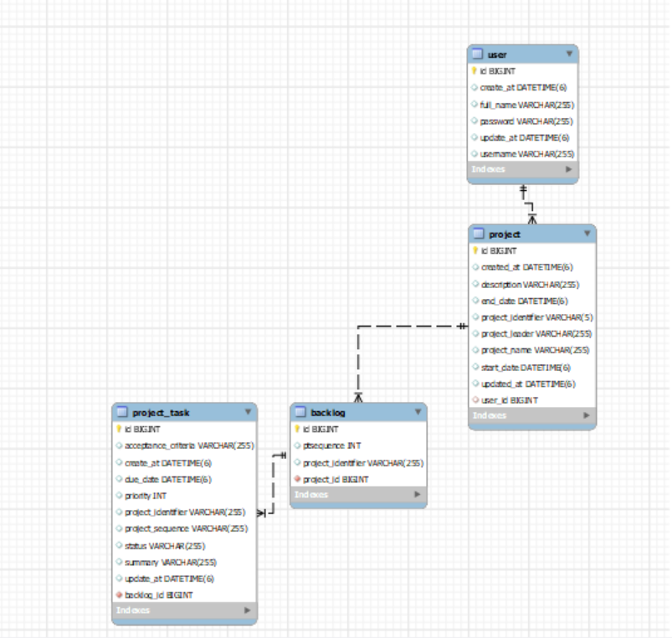
Database Design:

Slide 10
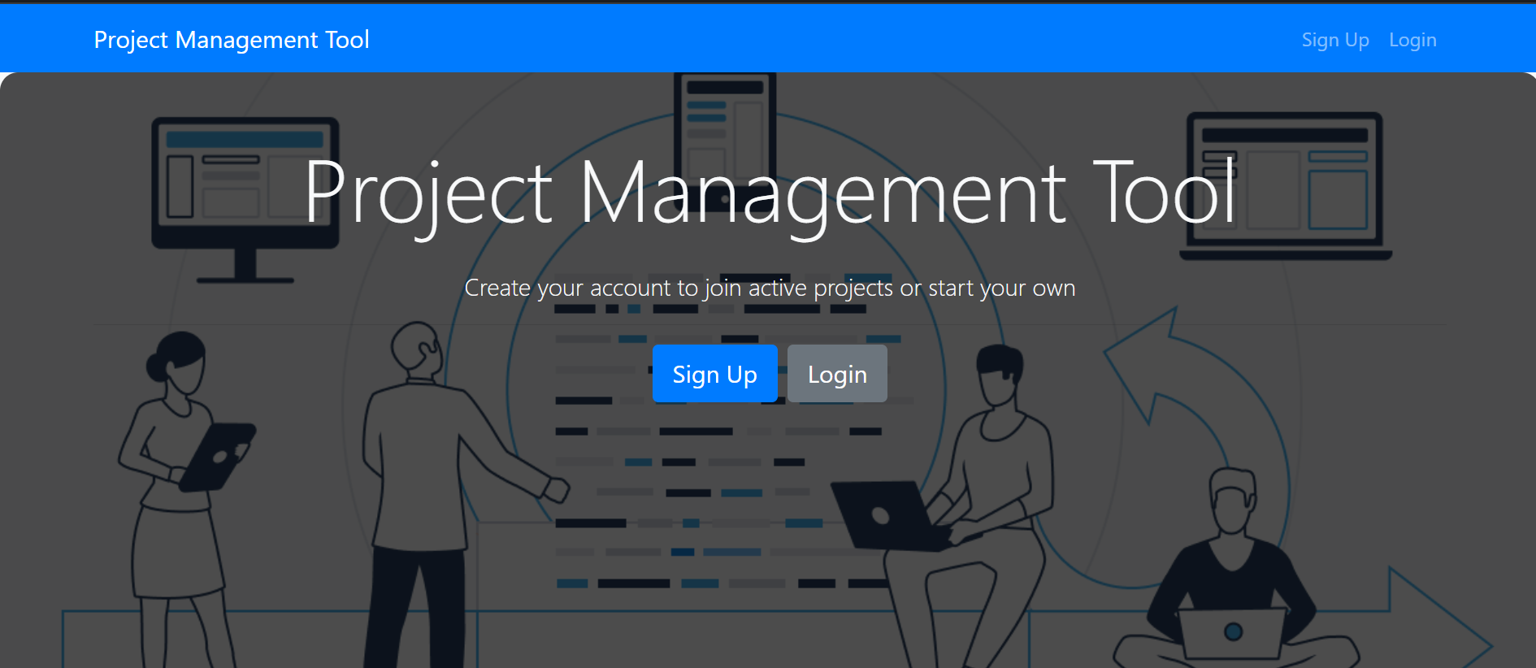
Implementation:
Home page:

Slide 11
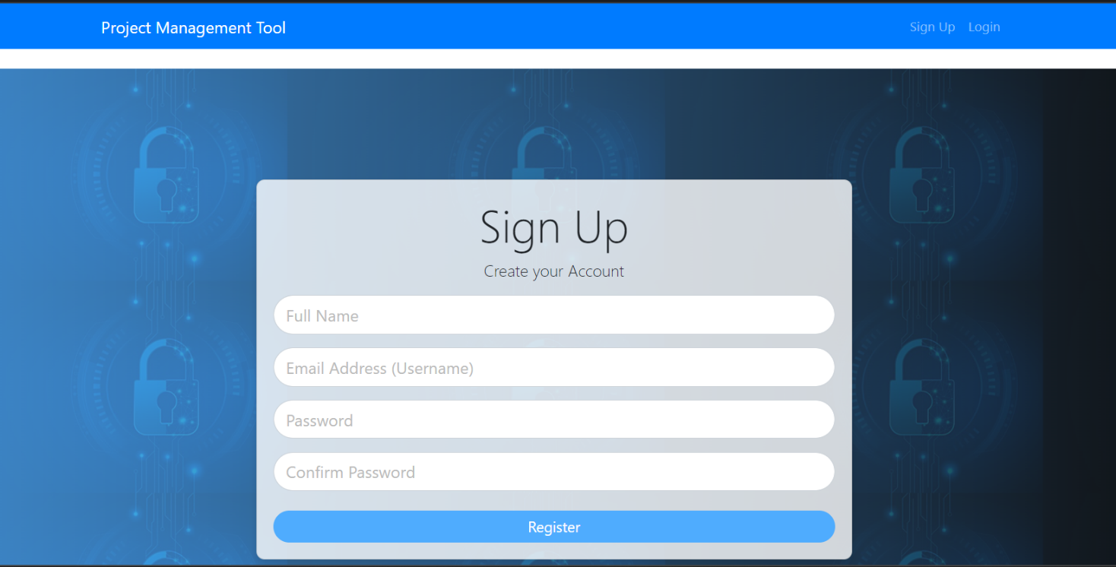
Register page:

Slide 12
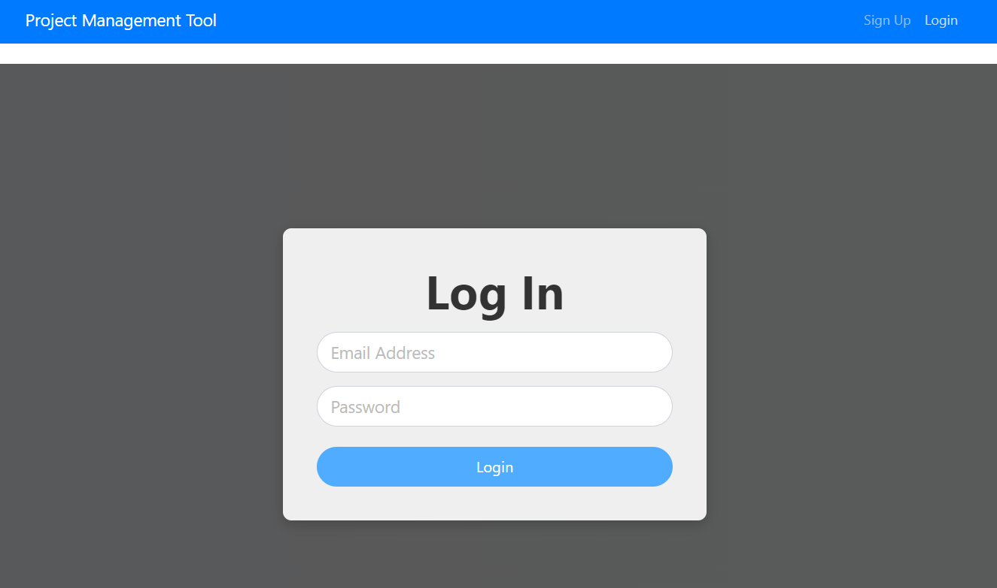
User login page:

Slide 13
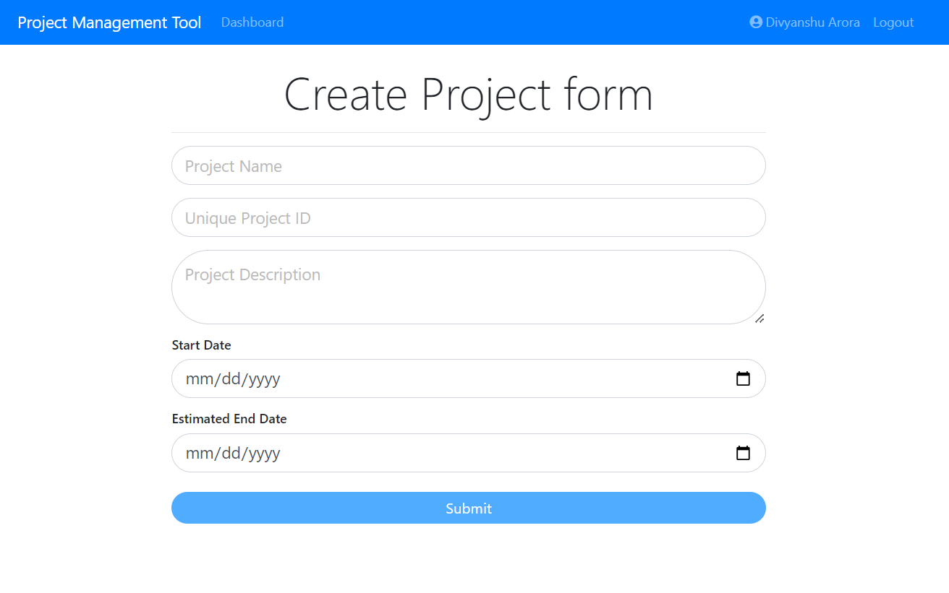
Project Creation :

Slide 14
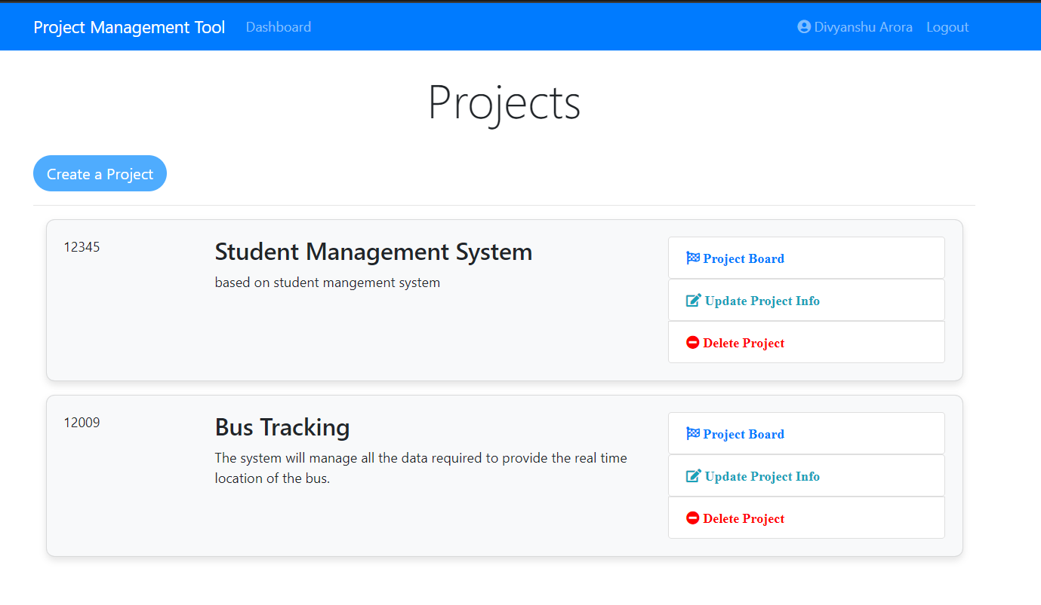
Project Details Page

Slide 15
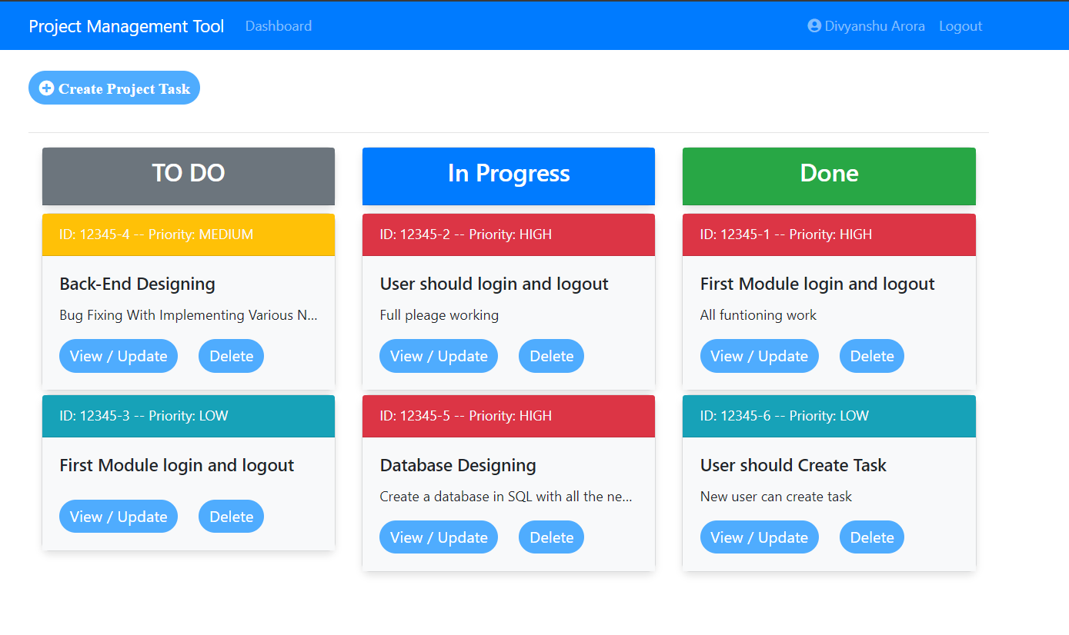
Project Board:

Slide 16
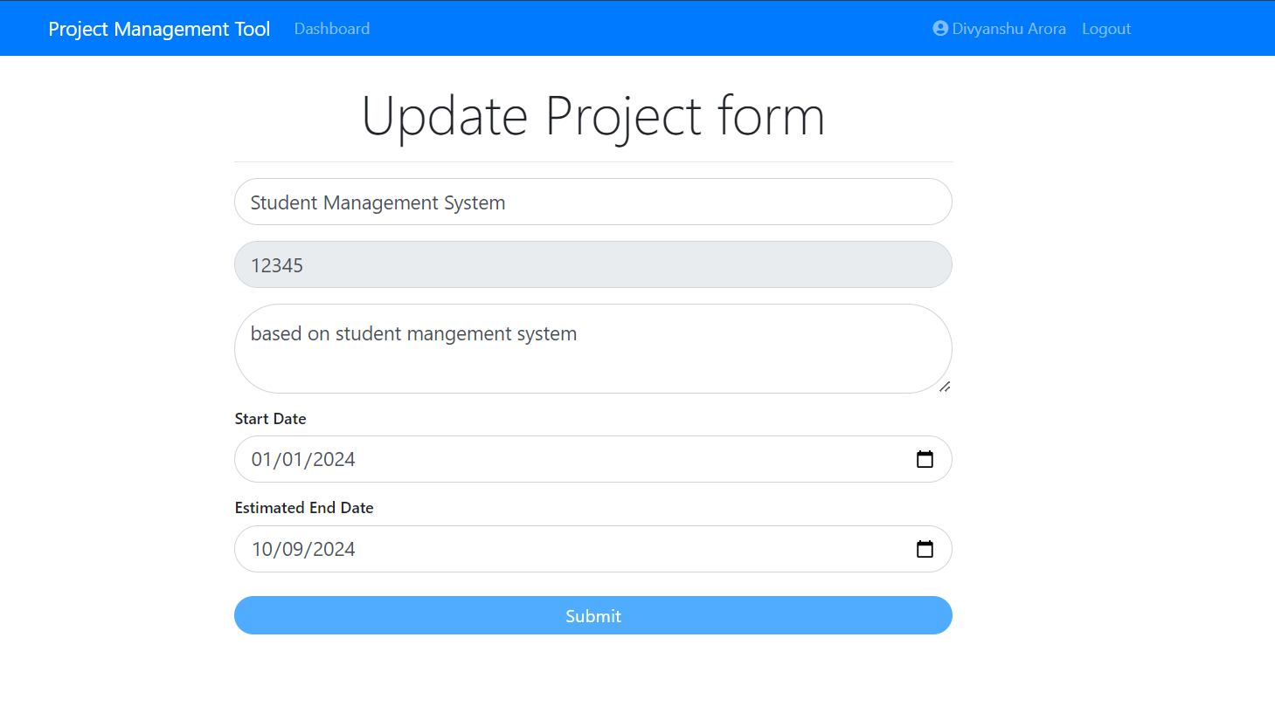
Update Project Details:

Slide 17
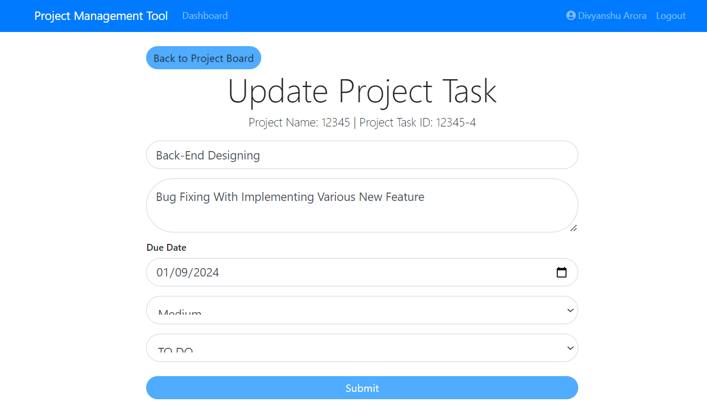
Update Project Task Details:

Slide 18
FUTURE SCOPE
The system will support different user roles, including Admin, Project Manager, and Team Member.
Users will be able to create, assign, prioritize, and track tasks within projects. Tasks can be categorized and filtered based on their status, priority, and deadlines, allowing for efficient task management.
The platform will include communication tools such as messaging, file sharing, and real-time notifications to facilitate collaboration among team members.
The tool will implement robust security measures to protect sensitive project data. This includes secure authentication, encryption of data, and regular backups to prevent data loss or breaches.
Users will have the ability to customize certain aspects of the tool, such as project templates, task categories, and user interface themes, to better suit their specific workflow and preferences.

Slide 19
The project management tool will be designed to scale according to the needs of the organization. Whether managing a single project or multiple concurrent projects, the tool will support growth without compromising performance.
The tool will provide budget tracking features, allowing project managers to monitor expenses against the project budget. This will help in managing project costs and ensuring financial efficiency.
The platform can offer client access features where clients can view project progress, provide feedback, and approve completed tasks. This enhances client engagement and satisfaction.

Slide 20
CONCLUSION
The platform offers a convenient and effective solution for managing small-scale projects, with an emphasis on user-friendly design and secure operations.
We define the problem on which we are working in this project.
We designed the simple user interface and resolved security issues of the system.
Finally, system is implemented and tested accordingly to the test cases.
At personal level we learned to work with team, implement software development technology and principles and good programing practice.

Slide 21
THANK YOU…

